Slide 1



HOME
SERVICE
ABOUT US
CONTACT US
SkyLock
AI-Enhanced Cloud-Based WAF
Supervisor
Dr. Mohamed Sobh
Page 01
Notes:
1

Slide 2
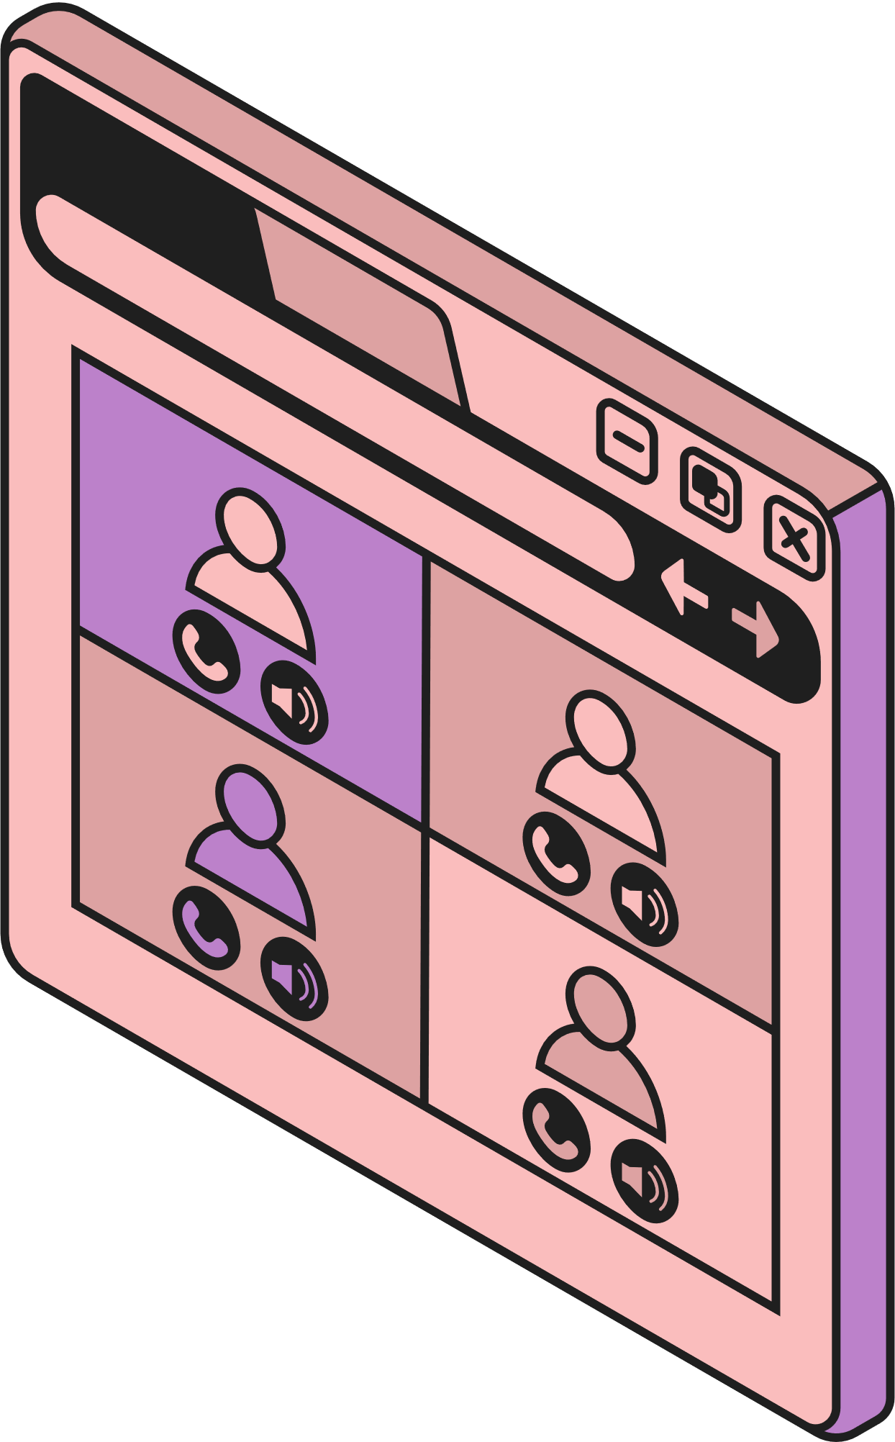
HOME
SERVICE
ABOUT US
CONTACT US
SkyLock
Team members
Marwan Wael Mohamed Abbas | 2001244
Abdallah Mohamed Ibrahim Gabr | 2001143
Ahmed Hossam Eldin Mohamed Ahmed | 2000075
Mohamed Ayman Abbas Zaki | 19P9201
Bigoal Shereen Soliman | 2001632
Kyrillos Ashraf Gamel | 2002015
Maged Moharam Abdelghaffar | 2001951
Omar Mohamed Mahmoud Al Tahan | 2001277
Mohamed Ayman Mohamed Soliman | 2001048
Page 02
Notes:
2

Slide 3

HOME
SERVICE
ABOUT US
CONTACT US
SkyLock
INTRODUCTION
➤ The application layer (Layer 7) has become the primary target for modern cyberattacks, with threats like SQL injection, cross-site scripting (XSS), and server-side request forgery (SSRF) on the rise.
➤ These sophisticated attack vectors are increasingly able to bypass legacy security solutions, leaving traditional Layer 3 and Layer 4 firewalls unable to provide adequate protection.
➤ Skylock is designed as an application-aware, modular reverse proxy, offering intelligent defense at the application layer.
➤ Built for flexibility, Skylock seamlessly integrates cloud-native environment—delivering adaptive security wherever your applications run.
Page 03

Slide 4
HOME
SERVICE
ABOUT US
CONTACT US
SkyLock
➤ Cyberattacks on web applications have left businesses and individuals exposed, with devastating consequences ranging from data breaches to service outages. Today, we’ll explore the scope of these threats, their impact on digital trust, and the urgent need for next-generation security.
➤ Advances in artificial intelligence and cloud computing are transforming the way organizations defend their assets, making security more proactive and adaptable than ever before.
➤ AI-driven methods—especially in threat detection, anomaly recognition, and automated response—have proven highly effective across cybersecurity, delivering robust protection in rapidly changing environments.
➤ By leveraging real-time machine learning and automated traffic analysis, modern solutions like Skylock significantly reduce response times and effort, providing organizations with an essential edge against evolving cyber threats.
Page 04

Slide 5


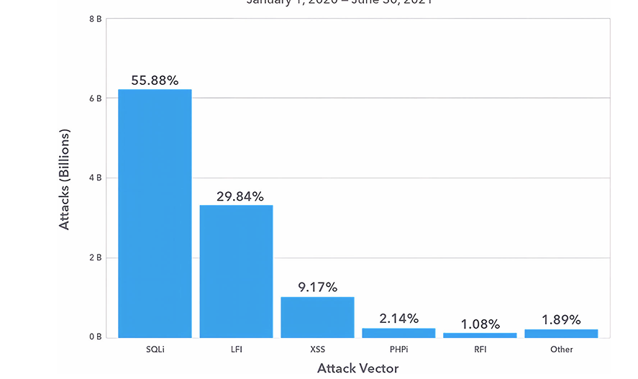
HOME
SERVICE
ABOUT US
CONTACT US
SkyLock
Problem definition
➤ Web application cyberattacks are rapidly increasing, while traditional WAFs—relying on static rules—struggle to keep up with new, evolving threats.
➤ Legacy WAFs lack unified dashboards and dynamic API controls, making them unsuitable for the demands of modern cloud-native environments.
Page 05

Slide 6
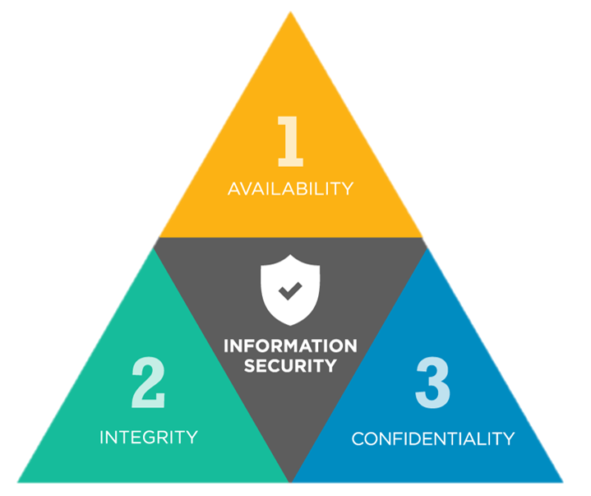
HOME
SERVICE
ABOUT US
CONTACT US
SkyLock
Objectives
Deliver a modular, API-driven WAF platform that enables real-time configuration and analytics through a user-friendly dashboard.
Support both rules-based threat detection and AI-powered anomaly classification to protect against evolving web attacks.
Provide top-attacker analytics, dynamic domain routing, and custom rule management, adaptable for cloud deployment.
Achieve high performance and seamless real-time adaptation, ensuring minimal latency and robust protection.
Uphold the Confidentiality, Integrity, and Availability (CIA) principles at every architectural level.
Page 06
Notes:
6

Slide 7

HOME
SERVICE
ABOUT US
CONTACT US
SkyLock
Related works
Open-Source Tools and Freeware for Web Application Security
Focus:
Freeware solutions like Shadow Daemon, ModSecurity, and Lua-Based WAFs combined with reverse proxies for enhanced web security.
Key Findings:
Reverse Proxies (e.g., Nginx/Apache):
Isolate web servers and enhance security by acting as an intermediary.
Shadow Daemon WAF, ModSecurity, Lua-Based WAF:
Flexibility: Customizable rule sets for various attack mitigation.
ModSecurity:
Cross-platform WAF for Apache HTTP Server, IIS, and Nginx.
Defends against injection attacks with a large rule set.
Lua-Based-WAFs:
Scalable open-source WAF based on OpenResty, supporting ModSecurity extended patterns.
Page 07
Notes:
7

Slide 8
HOME
SERVICE
ABOUT US
CONTACT US
SkyLock
System Architecture of SkyLock App
1. Client Layer: User/Web Client: Interacts via WAF homepage to register, manage WAFs, and send HTTP(S) requests.
2. Proxy Application Layer
OpenResty + ModSecurity: Acts as reverse proxy and enforces static WAF rules.
Lua Inspection Scripts: Extract request metadata, invoke AI module for analysis.
AI Microservice : Applies ML models to detect anomalies in suspicious traffic.
3. Management & Analytics Layer
Dashboard/UI: Allows users to monitor logs, manage WAF systems, and configure features.
Config API: Live updates for rules, rate limits, and domain mappings.
SQL Server: Stores user accounts, WAF settings, and event logs securely.
4. Data & Logging Layer
Log Parsers: Periodic audit and summarization of security logs.
Analytics Module: Highlights trends, frequent attackers, and WAF activity.
Persistent Storage : Archives all security events for analysis.
5. Backend Application Layer: Protected Web App (Client Server): Runs behind WAF, isolated from public access.
6. Cloud Infrastructure & Network Isolation
Google Cloud Virtual Private Networks: Segregates components (Default/Monitoring/Security).
Load Balancer & Static IP: Routes all external traffic through secure inspection pipeline.
Page 08
Notes:
8

Slide 9
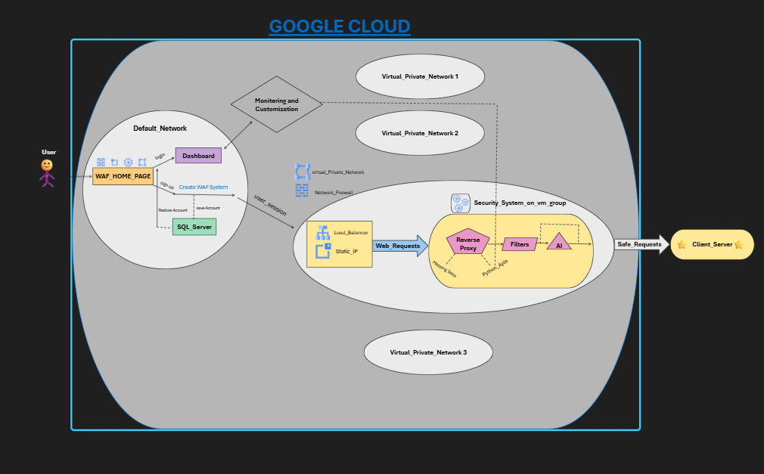
SkyLock
HOME
SERVICE
ABOUT US
CONTACT US
Page 09

Slide 10

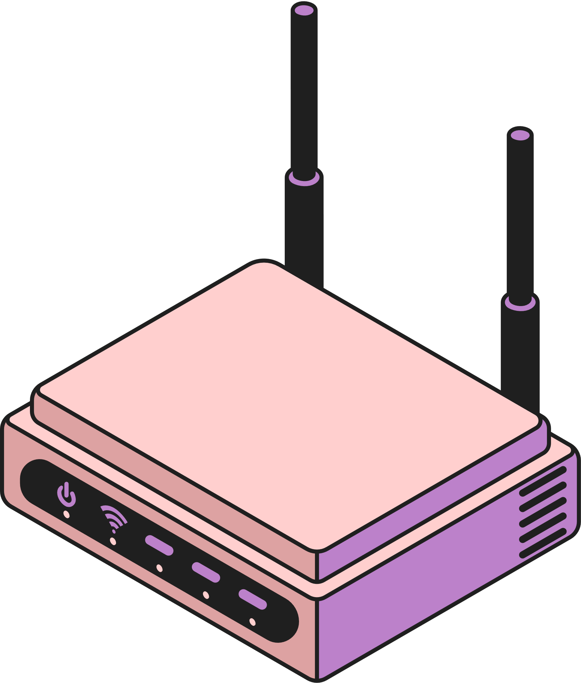
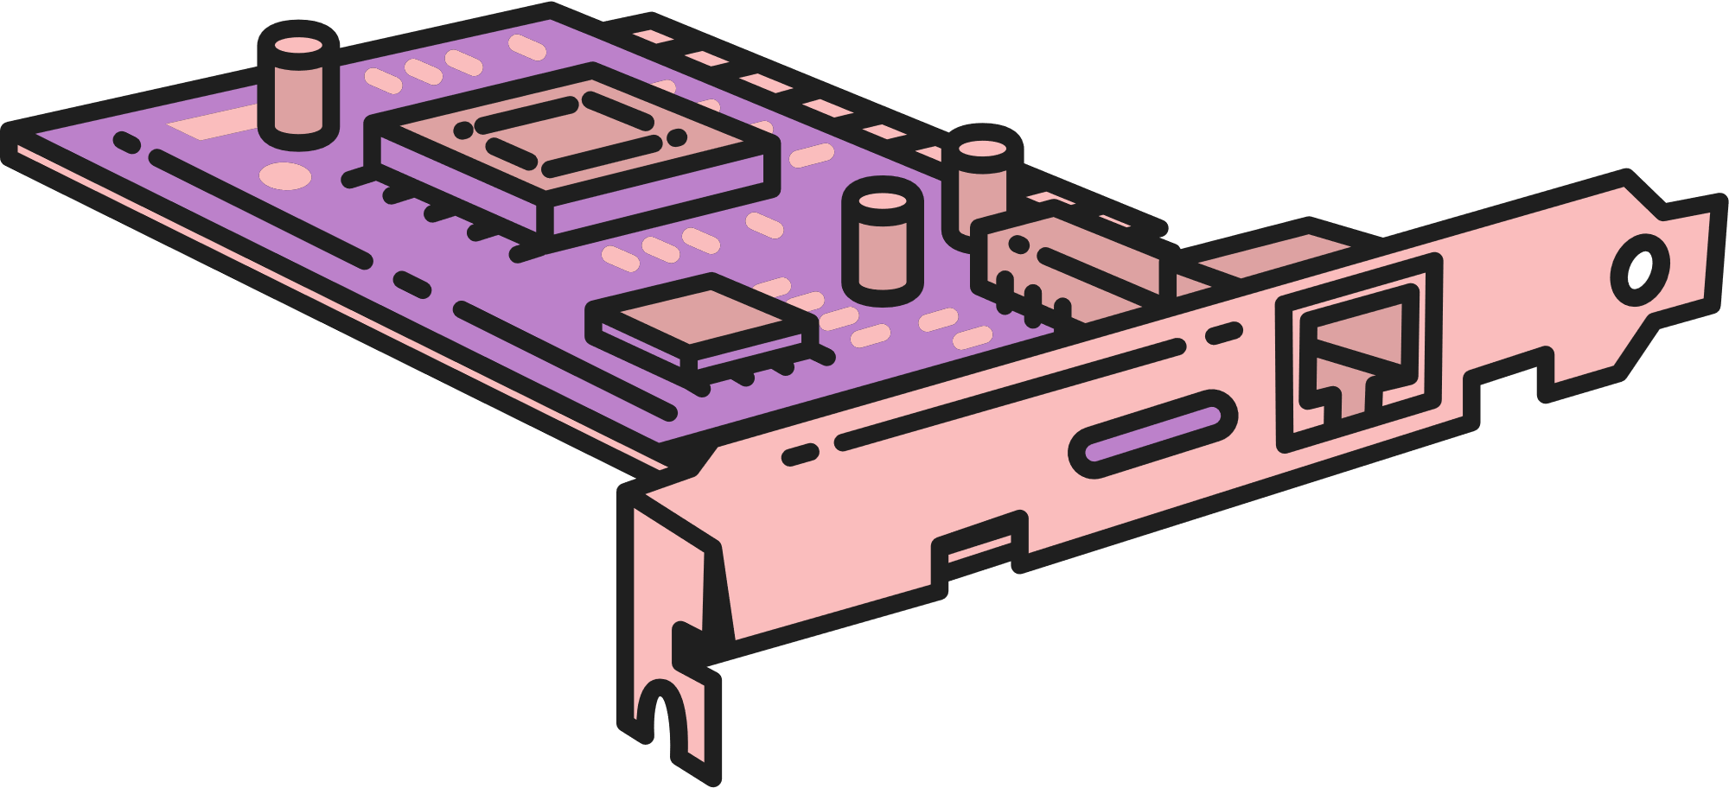
HOME
SERVICE
ABOUT US
CONTACT US
SkyLock
Functionalities
➤ Create Rule: Add dynamic ModSecurity rules via /Create-Rule (API or dashboard)
➤ Delete Rule: Remove a specific rule by ID using /Delete-Rule/<id>
➤ View Traffic Statistics: Get real-time counts of allowed and blocked requests through /Traffic
➤ Top Blocked IPs: Identify and visualize most frequent attacker IPs with /Top-Blocked
➤ Add & Remove Domain Mapping: Dynamically map domain to backend with /Add-Domain, undo with /Delete-Domain
➤ Update Rate Limiting: Control burst/rate via /Rate-Limit for proactive DoS and abuse mitigation
➤ AI Layer Toggle: Instantly enable or disable AI anomaly detection through /Toggle-AI
➤ Fetch Full Request Logs: Access detailed JSON logs of all inspected requests at /Requests
➤ User-Friendly Dashboard: All functionalities available through an intuitive web interface for easy monitoring and management
Page 10

Slide 11


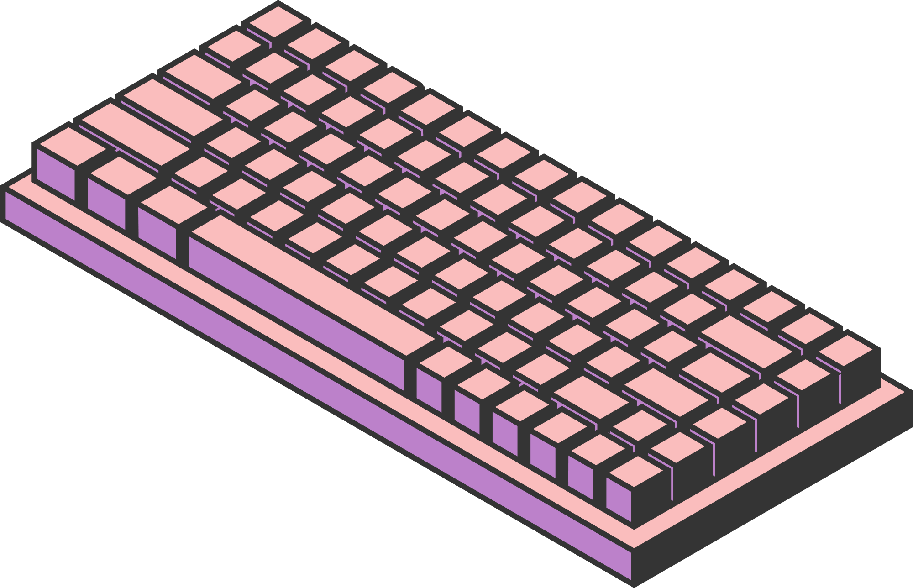
HOME
SERVICE
ABOUT US
CONTACT US
SkyLock
Our Work in each part
Page 11

Slide 12

HOME
SERVICE
ABOUT US
CONTACT US
SkyLock
Implementation
Overview
The Skylock platform integrates classical and modern approaches for defending web applications:
Layered WAF stack: Integrates ModSecurity on OpenResty for rules-based detection and protection.
Extensible: Designed for Pluggable AI module, cloud orchestration, and a modern dashboard.
Modular: Each functionality (filtering, analytics, management) runs independently, enabling easy maintenance.
Page 12

Slide 13

HOME
SERVICE
ABOUT US
CONTACT US
SkyLock
Implementation
Web Application Firewall (WAF) Core
➤ OpenResty with ModSecurity Integration:
Acts as a high-performance reverse proxy and the main entry point for web traffic.
ModSecurity enforces OWASP core rule set, applying signature- and anomaly-based detection to all HTTP(S) requests.
➤ Custom Rule and Rate Limiting:
Lua scripts support real-time traffic inspection and dynamic adjustment of rules and rate limits.
REST API enables remote injection, deletion, and management of security rules without manual reloads.
Page 13
Notes:
13

Slide 14
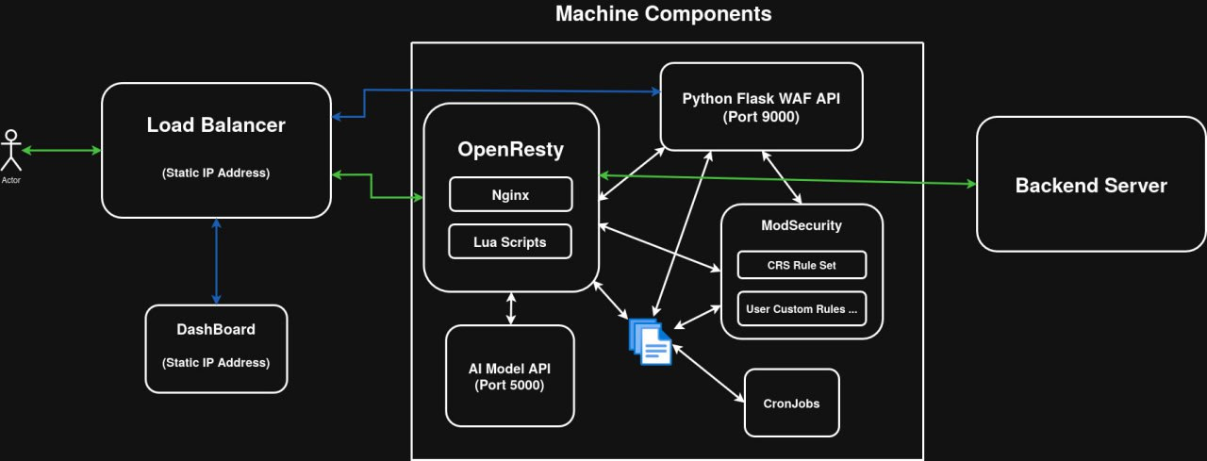
HOME
SERVICE
ABOUT US
CONTACT US
SkyLock
Page 14

Slide 15
HOME
SERVICE
ABOUT US
CONTACT US
SkyLock
Implementation
CLOUD CREATION AUTOMATION:
Create vpc network , its name = username.
Create network firwalls rule:
allow health check to access vm.
Allow icmp.
Allow internal accessing.
Allow ssh connection for admins.
Block any external http or https on vms. (low priority)
Create Subnets in the network.
Create instance template and copy ssd disk on it.
Create managed instance group.
Configuring autoscaling for Migs.
Reserve static ip address.
Create two Backend services.
Create forwarding rules for those backend services.
Create target proxy and attach to it rules and backends to make full load balancer.
Get load balancer ip.
Make firewall rule of allowing load balancer ip to access vms by https or http (high priority)
Page 15
Notes:
15

Slide 16
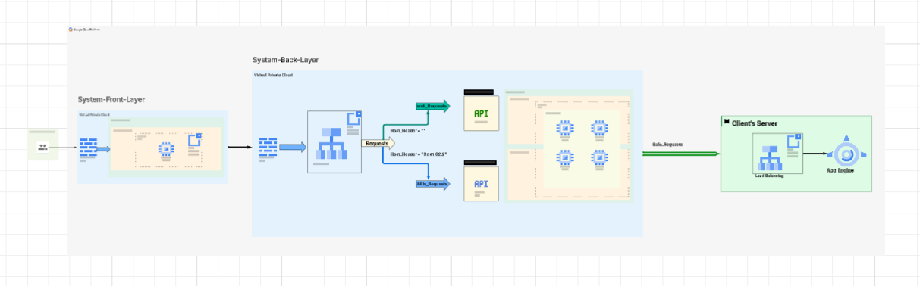
HOME
SERVICE
ABOUT US
CONTACT US
SkyLock
Implementation Cloud
Page 15
Notes:
16

Slide 17

Overview
HOME
SERVICE
ABOUT US
CONTACT US
SkyLock
Sign up
Page 16

Slide 18
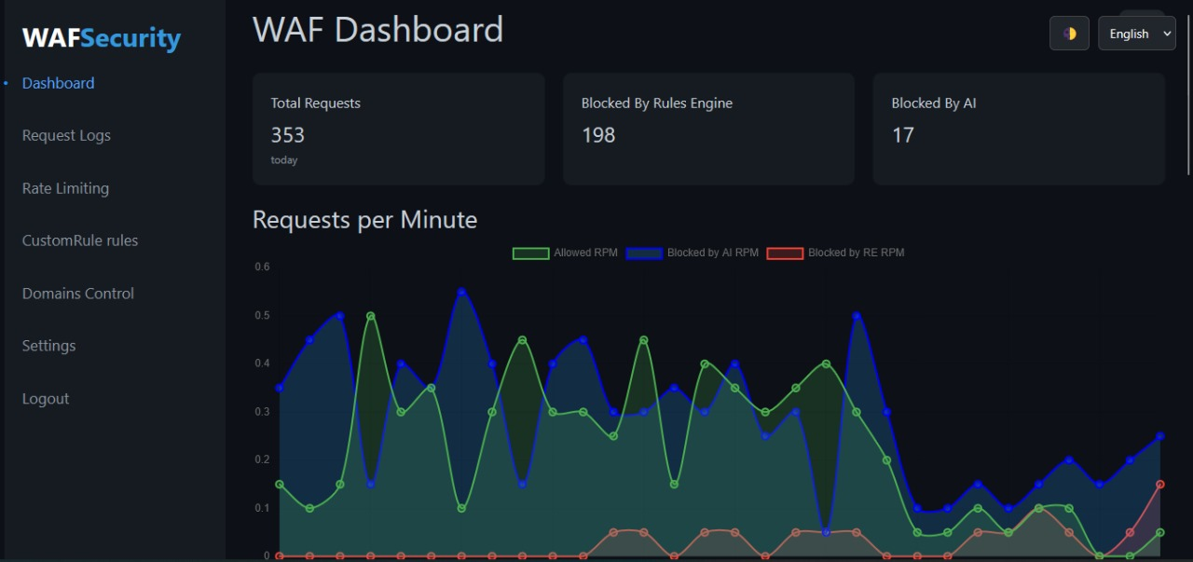
HOME
SERVICE
ABOUT US
CONTACT US
SkyLock
Page 17

Slide 19
HOME
SERVICE
ABOUT US
CONTACT US
SkyLock
Implementation
Key Features of WAF Dashboard
Comprehensive Security Monitoring & Management
Real-time Monitoring
Live request tracking (RPM)
Attack detection (SQLi, XSS, etc.)
Domain & Rule Management
Add/remove protected domains
Custom rule configuration
AI/rule-based blocking toggle
Rate Limiting
Visualize request spikes
User-Friendly UI
Dark/light mode
Bilingual (English/Arabic)
Responsive card-based layout
Page 18
Notes:
19

Slide 20
HOME
SERVICE
ABOUT US
CONTACT US
SkyLock
Technology Stack of WAF Dashboard
Layer | Technologies
Frontend | HTML5, CSS3, JavaScript, Chart.js
Backend | ASP.NET Core MVC (C#)
Security | JWT, Anti-Forgery Tokens
Data Flow | Fetch API (3s polling)
Page 19

Slide 21
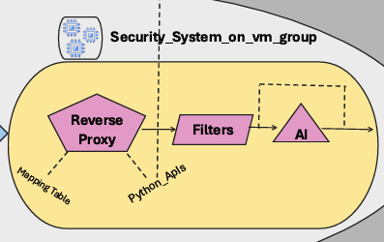
HOME
SERVICE
ABOUT US
CONTACT US
SkyLock
Implementation
Key Features of AI model in system:
➤ This layer contains the last model chosen based on the models’ performance on the test quires after being trained on the final data.
➤ This layer is tuned to be compatible with other layers without affecting their performance or making a delay.
➤ The model used passed by several steps:
Data cleaning
Vectorization using TF-IDF
Modeling using Linear SVM
Then each new request is tested by the model to predict if it is safe or malicious
Page 20
Notes:
21

Slide 22
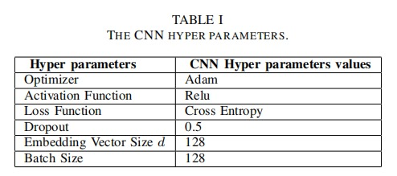
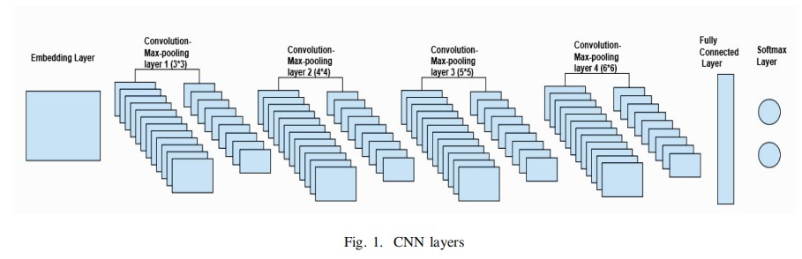
HOME
SERVICE
ABOUT US
CONTACT US
SkyLock
SWAF Based on CNN paper
The Embedding layer: It receives the data input by batch and embeds each data input to a vector of dimension d. The batch size value presents the initial number of neurons. Both the embedding vector size and batch size value significantly affect the training and testing speed.
Convolutional and max pooling layers: These two layers work together. They are characterized by three hyperparameters optimizer, activation function, and filter size.
Fully Connected Layer (FCL): All its neurons are linked to all neurons in max pooling layer. It is characterized by the dropout value that drops the unnecessary neurons.
SoftMax Layer: This layer contains two types of decision-making neurons. It decides whether an HTTP request is normal or malicious.
Page 21
Notes:
22

Slide 23
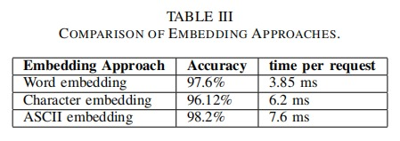
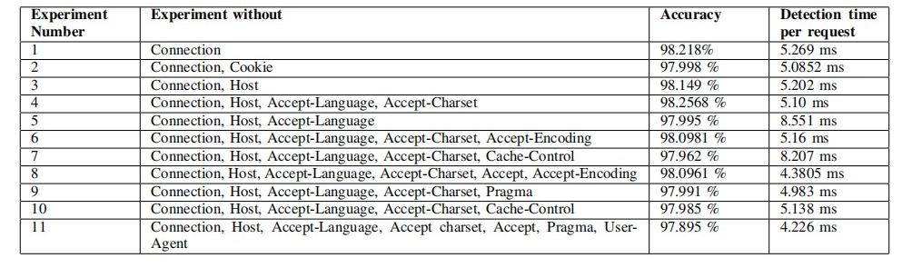
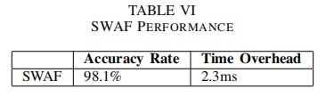
SkyLock
HOME
SERVICE
ABOUT US
CONTACT US
SWAF Based on CNN paper
HTTP request was divided into two parts: the request line
and the header parts (Field, General, and Entity).
B) Header Parts of HTTP Request Being Filtered (in condition
that the accuracy doesn’t be less than 98%):
It is concluded that removing the unnecessary parts for attack detection are (Connection, Host, Accept-Language, and Accept-Charset) achieved the highest accuracy (98.2568%) among the other experiments, but the detection time per request isn’t the smallest (5.10ms).
The detection time could be minimized by decreasing the batch value & embedding vector size to 64.
Page 22
Notes:
23

Slide 24

HOME
SERVICE
ABOUT US
CONTACT US
SkyLock
Ai Modelling
Dataset overview
➤ The final dataset we used to improve our Ai model was a collection of outsourced security dataset from trusted cybersecurity consortium on GitHub which are published this year, so they are up to date.
➤ This data consists of:
Benign Queries (Safe): 1,413,061 samples
Malicious Queries (Attacks): 50,896 samples
Examples: SQL injection, XSS, Path Traversal, Command Injection,….,etc.
➤ We find data more than that, but we decided to filter the records with bad attributes or dummy data before processing to ensure the quality over quantity.
Page 23

Slide 25
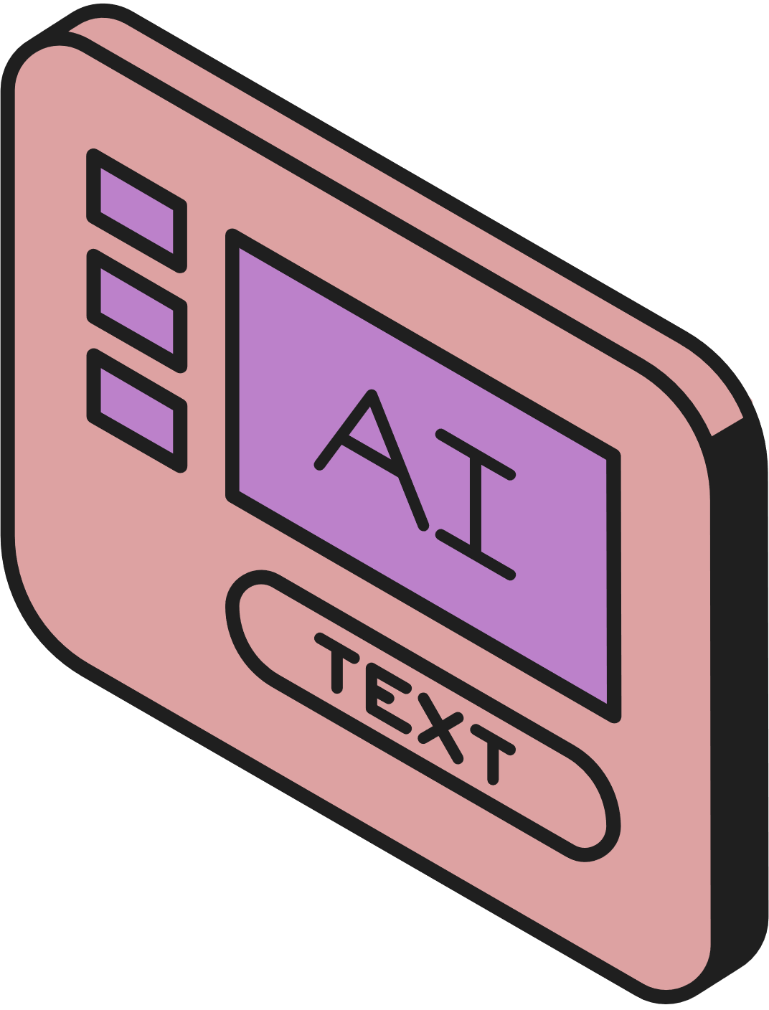

HOME
SERVICE
ABOUT US
CONTACT US
SkyLock
Ai Modelling
Ensemble Framework for Heterogeneous Datasets
➤ The heterogeneity of the datasets, an ensemble method was selected as the final strategy.
➤ we handled differences in feature distributions and labeling between datasets. Enables modular development, debugging, and replacement of individual models.
➤ Implementation Steps:
we trained individual models on each dataset separately, ensuring optimal performance within each domain.
Use a meta-model logistic regression that takes the predictions of the individual models as input to make the final decision.
Page 024

Slide 26
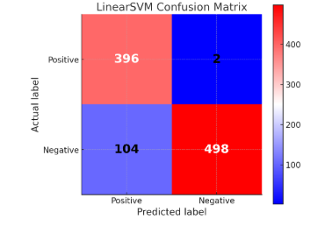
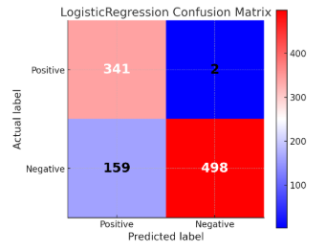
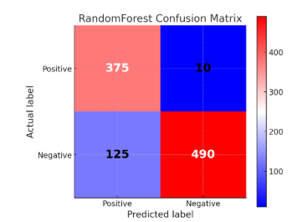
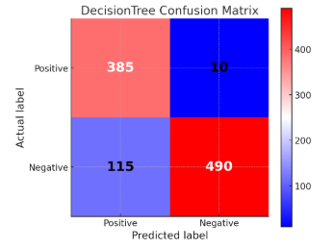
HOME
SERVICE
ABOUT US
CONTACT US
SkyLock
Ai Modelling
Modelling process
➤ First, we applied TF-IDF on the records, then, we trained all the machine learning models (linear SVM, logistic Regression ,decision Tree ,random Forest), and deep learning models(DistilBERT, LSTM, XGBoost, LightGBM, CNN, Deep FCNN).
➤ Second we tested all these models on 1000 Queries(500 Safe Queries, 500 Malicious Queries), and measure the score of each model according to these critical dimensions:
Accuracy
Precision
Recall
F1-Score
Runtime
Page 25
Notes:
26

Slide 27
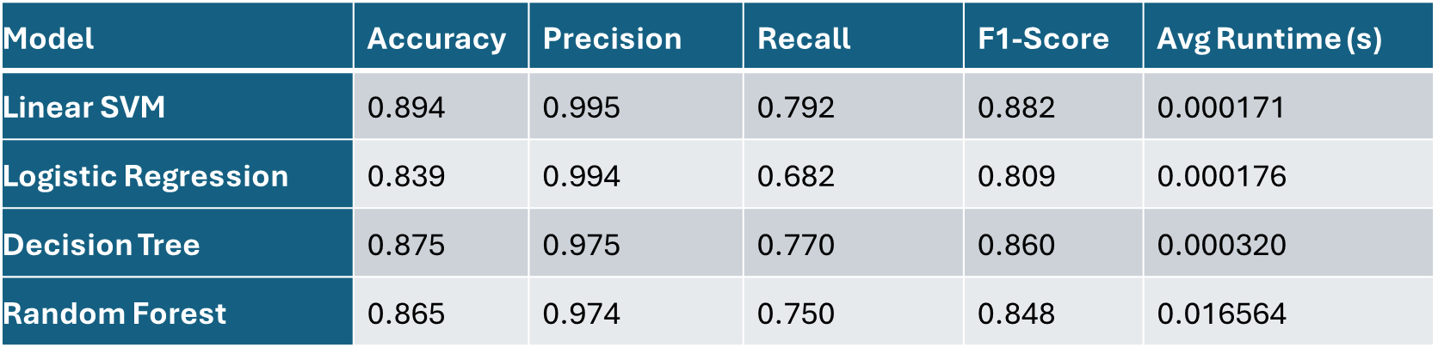
HOME
SERVICE
ABOUT US
CONTACT US
SkyLock
Ai Modelling
Final results
➤ Linear SVM Dominance:
Highest accuracy (89.4%) and F1-score (88.2%), confirming optimal precision-recall balance.
Best precision (99.5%) → only 2 false positives (legitimate requests blocked).
2.5× faster than Decision Tree and 97× faster than Random Forest.
Page 26
Notes:
27

Slide 28



HOME
SERVICE
ABOUT US
CONTACT US
SkyLock
Comparison with Existing WAFs
ModSecurity: Powerful open-source rules engine, but lacks dynamic APIs, real dashboard, or built-in rate limiting; configuration is manual and not cloud-native by default.
AWS WAF: Fully managed with dashboard, easy scaling, integrated logging, and solid rule coverage, but expensive, complex pricing, and limited support for custom AI or advanced analytics.
Cloudflare WAF: Simple to deploy, great dashboard, and advanced features (Bot Management, DDoS mitigation), but proprietary, may require Enterprise plan for granular controls, and limited custom logic.
Skylock: Combines open-source foundations (ModSecurity) with modular AI, API-based config, live dashboard, and is designed for cloud setup. – Unique in providing custom rule API, pluggable AI, and instant rate/domain control in an open, extensible platform.
Page 27

Slide 29
HOME
SERVICE
ABOUT US
CONTACT US
SkyLock
Comparison with Existing WAFs
Feature | ModSecurity | AWS WAF | Cloudflare WAF | Skylock
Rule-Based Protection | ✔️ | ✔️ | ✔️ | ✔️
Custom Rule API | ❌ (manual only) | ⚪ (console) | ⚪ (dashboard) | ✔️ (REST+UI)
AI/ML-Powered Filtering | ❌ | ⚪ (add-on $) | ❌ | ✔️ (modular)
Rate Limiting | ⚪ (extra config) | ✔️ | ✔️ | ✔️ (API/GUI)
Dashboard/UI | ❌ | ✔️ | ✔️ | ✔️ (custom)
Domain Routing | ⚪ (manual config) | ✔️ | ✔️ | ✔️ (API/GUI)
Log Analytics | ⚪ (manual/ELK) | ✔️ | ✔️ | ✔️
Symbols: ✔️ Yes | ⚪ Partial/Limited | ❌ No
Page 28

Slide 30

HOME
SERVICE
ABOUT US
CONTACT US
SkyLock
Conclusion
➤ ModSecurity layer in the system has many weak points, by doing sophisticated penetration testing on it.
➤ The AI model provides more security and takes over the filters gaps, which was really an important approach in our project.
➤ We can’t use deep learning models in our AI model due to speed limitation, we used machine learning models and tried to balance between speed and accuracy.
➤ It is possible that false positives occur, and it can be solved by continuously updating the data given to the AI model for training by recent datasets or from the reports from the clients.
Page 29
Notes:
30

Slide 31
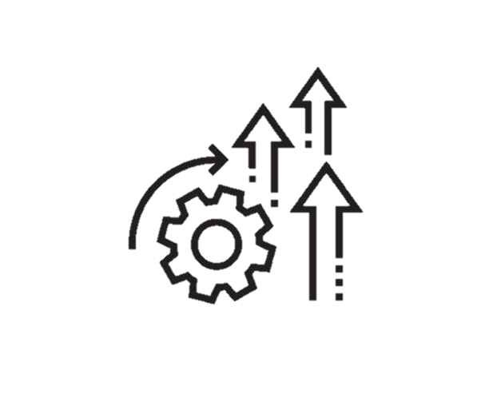
HOME
SERVICE
ABOUT US
CONTACT US
SkyLock
Future Enhancements
➤ Real-Time Log Streaming & Alerting • Integrate with ELK stack, Prometheus/Grafana, or native email/SMS for live event monitoring and instant security alerts.
➤ Continuous Model Training & Drift Detection • Support for ongoing AI model retraining from fresh attack logs (shift right testing).
➤ Multi-Cloud Support – Extend to AWS/Azure.
➤ Full API Documentation & SDKs • Publish open API docs and SDKs for easy integration with CI/CD and external tools.
➤ Automated Threat Intelligence Feeding • Connect to community or commercial threat feeds for automatic rule or indicator updates.
Page 30
Notes:
31

Slide 32
HOME
SERVICE
ABOUT US
CONTACT US
SkyLock
Continue..
Page 31

Slide 33
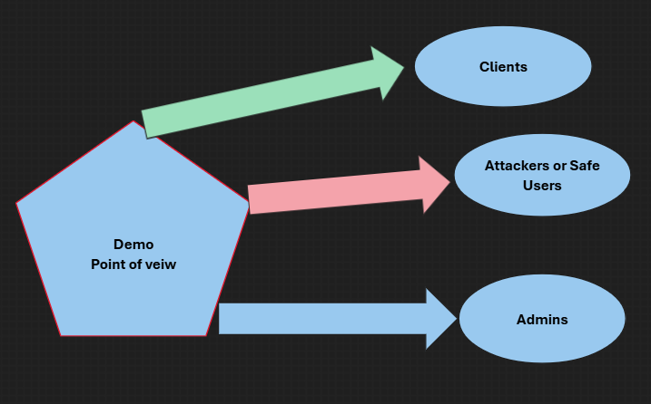
HOME
SERVICE
ABOUT US
CONTACT US
SkyLock
Continue..
Page 32

Slide 34



HOME
SERVICE
ABOUT US
CONTACT US
SkyLock
THANK YOU

